Slide 1

Data Analyst
Practical Exam

Slide 2

Context & Business Goals
The sales team needed to understand which sales approach : Email, Call, or Email + Call, performs best for the new product line. The objective was to determine which method maximizes revenue while optimizing the team’s effort.
Business Questions :
How many customers were acquired through each sales method?
How does revenue vary across and within methods?
Did performance evolve over time?
Which method offers the best trade-off between results and time investment?
Goal :
Provide a clear, data-driven recommendation to guide the next campaign strategy and help balance efficiency and customer value.

Slide 3





Analytical Approach
To identify the most effective sales method a structured analysis was conducted in four main steps :
Data Validation and Cleaning
Business Metric Definition
Verified consistency across 15,000 records and 8 variables
Standardized sales methods and corrected invalid values
Combined results to guide next campaign strategy
Aligned insights with business goals and operational feasibility
Step I
Step II
Step III
Step IV
Exploratory Data Analysis
Recommendations
Explored customer distribution, sales volume, and revenue patterns
Compared performance across methods, weeks, and regions
Key takeaways on method performance
Strategic guidance for next campaign

Slide 4
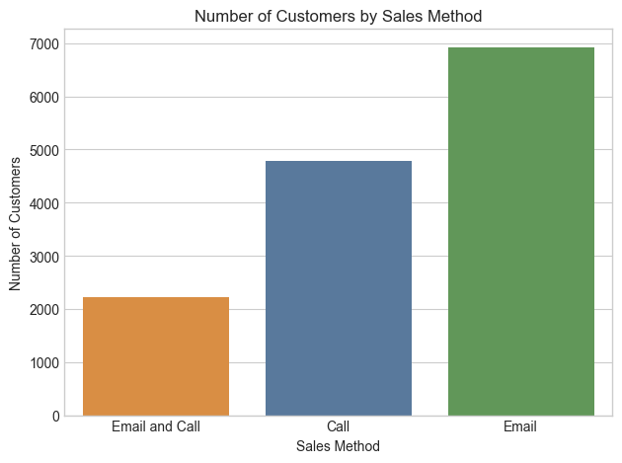
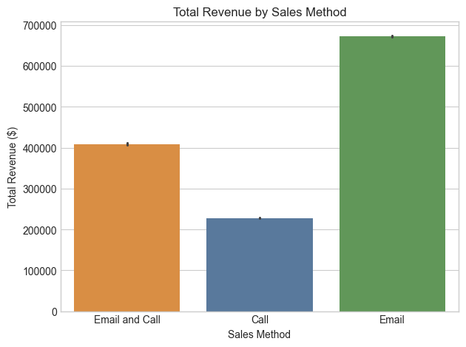
Key Findings
(How many customers were there for each approach ?)
By analysing the customer Reach and the total Revenue by Sales Method, we observe that :
Email reached the largest number of customers, giving it the widest campaign coverage. As a result, total revenue from Email is the highest among the three methods.
The Call method reached fewer customers than Email but more than Email + Call, yet it generated the lowest total revenue overall.
Email+Call approach, while targeting the smallest audience, still achieved higher total revenue than Call, ranking second overall.
These initial results already raise an important question : How can a method with the smallest reach still outperform another in total revenue ? We’ll seek to better understand this dynamic in the next steps of our analysis.

Slide 5
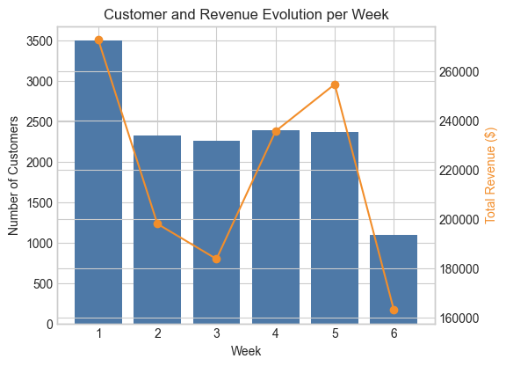
Key Findings
(Was there any difference in revenue over time for each of the methods ?)
We can also observe that the first week of the campaign brought in the highest number of customers, followed by a stable phase from Week 2 to Week 5, before a clear drop in Week 6.
However, the revenue trend does not mirror the customer acquisition curve.
Despite a decline in new customers after Week 1, total revenue remains strong in Weeks 4 and 5, indicating that fewer customers generated more value during that period.
This divergence between volume and value continues the earlier question : What changed during those weeks that led to higher profitability despite fewer acquisitions ?

Slide 6
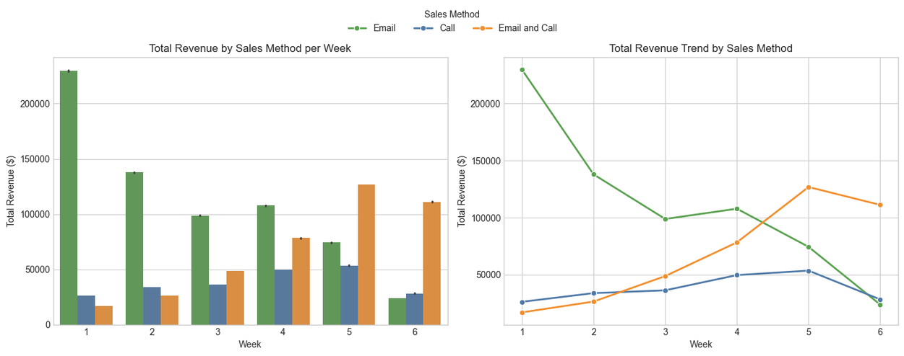
Key Findings
(Was there any difference in revenue over time for each of the methods ?)
Looking at how revenue evolved over time — but this time broken down by sales method — we begin to resolve part of our earlier question. The mismatch between customer acquisition and total revenue now appears to be driven by the Email+Call method.
Although it started behind, its revenue grew steadily and eventually surpassed the other methods from Week 5 onward.
So while Email brought the most customers, it’s Email+Call that ultimately generated the most revenue in the final stages of the campaign.
Which brings us back to our original question : How can a method with fewer customers end up being more profitable ?

Slide 7
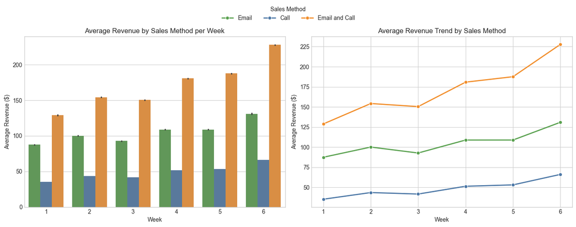
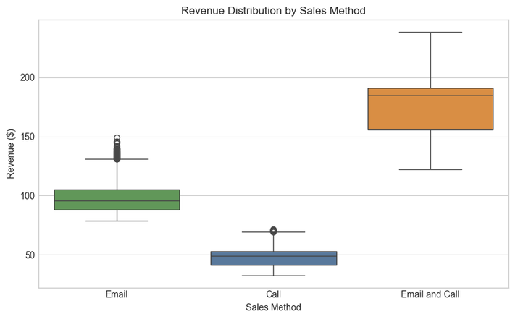
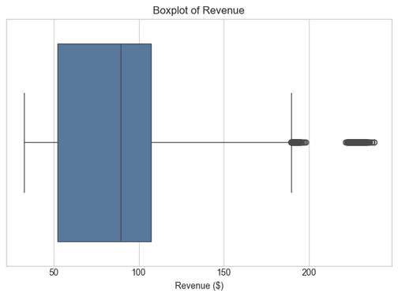
Key Findings
(What does the spread of the revenue look like overall? And for each method ?)
Continuing our earlier investigation, we can clearly see from the focus on average revenue per customer that
Customers acquired through Email+Call bring in the highest revenue on average, well above the other two methods. The Email approach, although it reaches the largest number of customers, drives a lower individual revenue level.
This contrast suggests that while email campaigns are effective for broad acquisition, the combined approach clearly delivers better financial results per customer
Weekly trends confirm this: while other methods remain relatively stable, the Email + Call strategy sees a sharp rise in average revenue per client as the campaign progresses.

Slide 8
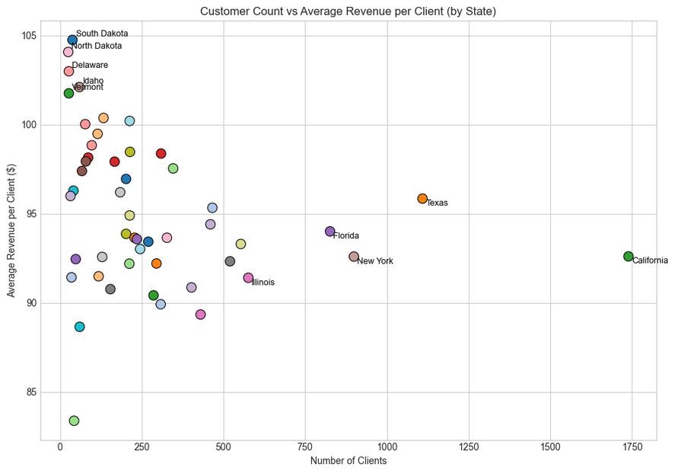
Key Findings
Before wrapping up, we also investigated other factors such as customer tenure, product quantity, or website activity to explain revenue variation. However, no meaningful patterns emerged from those variables, they showed little to no impact on customer value or method performance. We then turned to geographic segmentation.
We can see two very distinct profiles emerging. States such as California, Texas, Florida, and New York concentrate the largest number of clients, but their average revenue per customer remains moderate. These are high-volume markets where reach drives performance more than individual value.
On the other side, smaller states like South Dakota, North Dakota, Delaware, Idaho, and Vermont show the highest average revenue per client despite limited customer bases. These regions reflect high-value engagements, possibly more suited for resource-intensive methods like Email and Call.

Slide 9
Business Metric Definition
To monitor performance over time, the business needs a metric that reflects both the financial return and the operational effort required by each sales method. Based on the analyses, two complementary indicators emerge as relevant for evaluating campaign efficiency.
1. Revenue per Hour — Efficiency Metric
This metric measures how much revenue each sales method generates per hour of estimated effort.
Total Revenue
Revenu per Hour =
Total Time
Using the current dataset and time assumptions per client
Email : 1 min (estimated),
Call : 30 min,
Email + Call : 10 min
we obtain :
Sales Method | Revenue per Hour
Call | 95.19 $
Email | 5827.66 $
Email+Call | 1101.91 $
Notes:
This metric measures how much revenue each sales method generates per hour of estimated effort.
It combines both performance and cost-of-execution, offering a practical way to compare methods that require different levels of human involvement.

Slide 10
Business Metric Definition
2. Average Revenue per Client — Value Metric
This second metric focuses on the average value generated per customer.
Using the current dataset, we obtain :
It reflects the quality of engagement and sales effectiveness of each method, regardless of the time spent.
Sales Method | Average Revenue per Client
Call | 47.60 $
Email | 97.13 $
Email+Call | 183.65 $
Total Revenue
Average Revenue per Client =
Number of Customers
Notes:
This metric measures how much revenue each sales method generates per hour of estimated effort.
It combines both performance and cost-of-execution, offering a practical way to compare methods that require different levels of human involvement.

Slide 11
Summary and Recommandations
Summary of Key Findings
Across the six-week campaign, results showed clear differences in how each sales method performed:
Email reached the widest audience, generating a great total revenue through volume, though with lower value per customer.
Call proved inefficient both in scale and return — it required the most time for the weakest results.
Email and Call achieved the highest average revenue per customer, confirming that deeper engagement drives stronger conversions.
Geographical and tenure analyses revealed that these patterns are consistent across states and customer profiles. However, regional variations in customer concentration and purchasing power suggest that not all methods should be deployed uniformly.

Slide 12
Summary and Recommandations
Recommendations
The choice of method should depend on the objectives and priorities of the next campaign:
As they offer low return for high effort, Call only campaigns should be discontinued in favor of Email+Call
Email should remain the primary method in large, high-density states (e.g., California, Texas, New York), where automation and reach maximize efficiency.
Email and Call should be intensified in smaller or less populated regions (e.g., Vermont, Delaware, Idaho), where engagement per customer is higher and the average basket value justifies the additional effort.
Ultimately, the most effective approach will depend on whether the company prioritizes volume (Email) or value (Email and Call).

Slide 13


Thanks for you attention !

